Slide 1
Tubesat CDR
(COVID-19: Design Revisited)
Shawn Nase, Jimmy Oakes, Zach Cullen, Mark Bright
Electrical Engineering Department
Zoom University

Slide 2
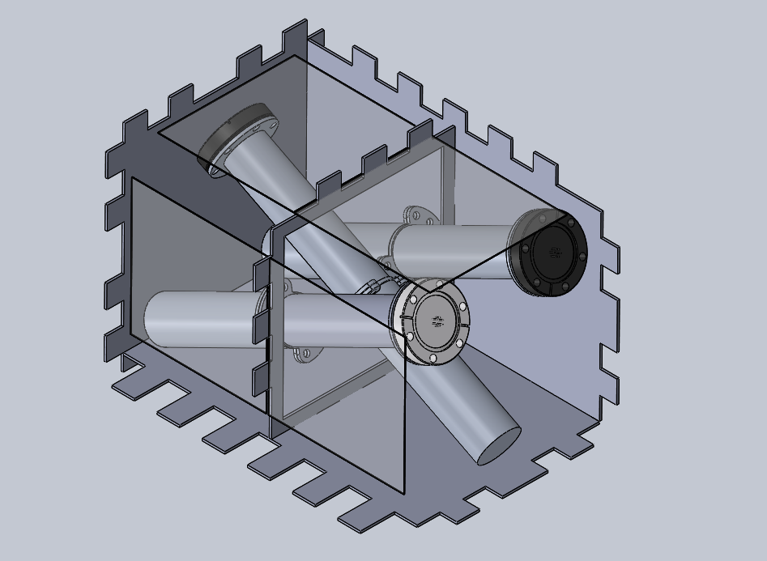
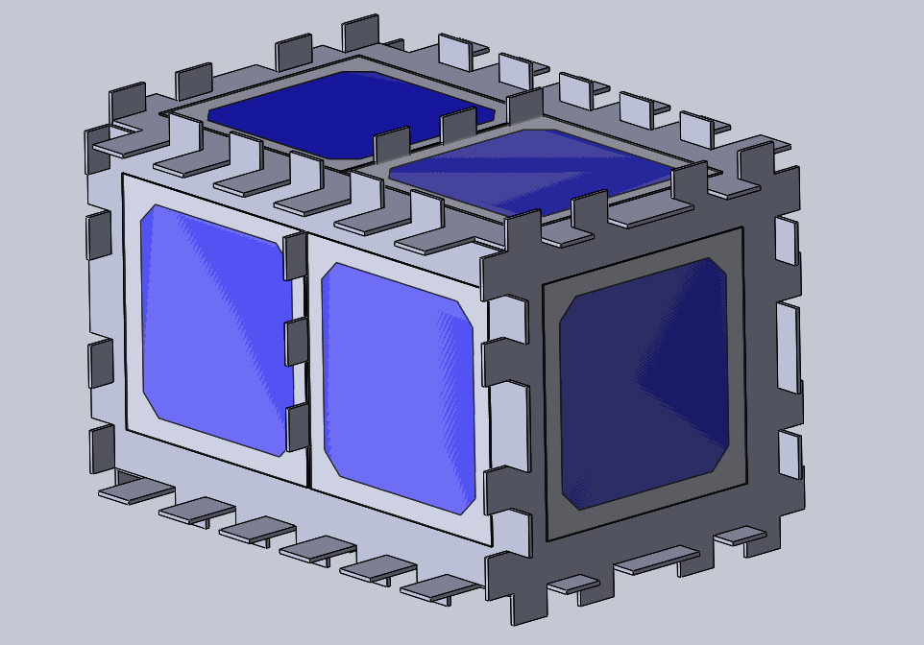
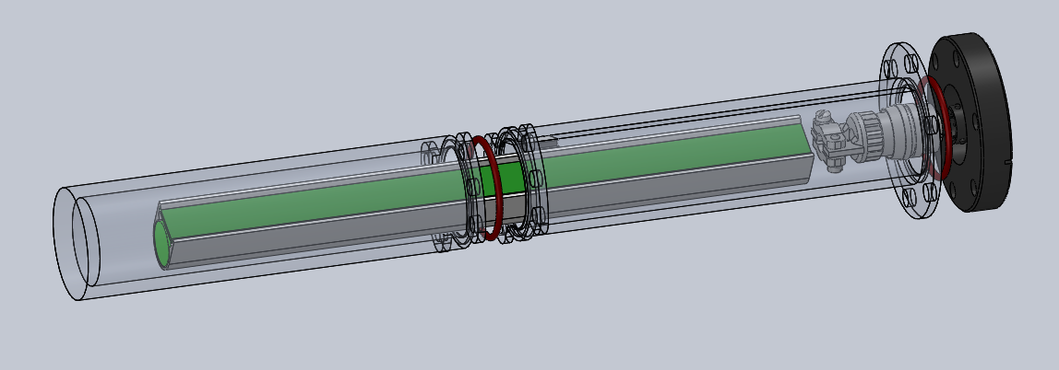
Recap of the Tubesat
Open source, low cost, modular satellite design using COTS components
COTS components are not space rated → Must shield against thermal, vacuum, and radiation environment of space
Batteries and electronic modules shielded within tube; power provided via solar cells
Original goal: continuously and synchronously blink an LED under simulated environmental conditions

Slide 3

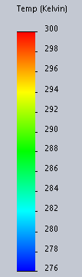

Technical Progress
Digital Processing Circuit (DPC) and Power Management Circuit (PMC) modeled in Multisim and Ultiboard to meet PCB sizing constraints imposed by housing
Vacuum and vibration testing arrangements were being made with space lab; had difficulties
Due to COVID-19, pivot to analysis and simulation based approach including:
Thermal Modeling and Simulation
Leak Rate Calculations
Power Budgeting

Slide 4
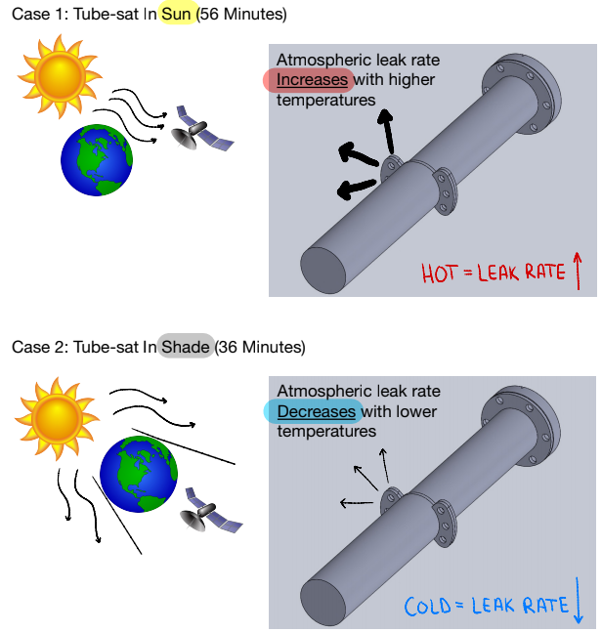
Leak Rate
Leak Rate = 0.7*F*D*P*Q*(S^2)
Variables are permeability and Q-factor
Permeability of silicone directly proportional to temperature, Q-factor dependant on o-ring compression
Permeability of air through silicone o-ring found in Permeability Table
Q-factor is determined by the compression of the o-ring
Worst-case scenario: satellite at constant 72°F → air pressure inside casing roughly 75% of starting air pressure
Air pressure inside casing drops from 14.7 psi to 12.83 psi after six months, above our goal of 12 psi
Site used to calculate leak rate:
https://www.engineersedge.com/fluid_flow/oring_leak_rate_13605.htm

Slide 5
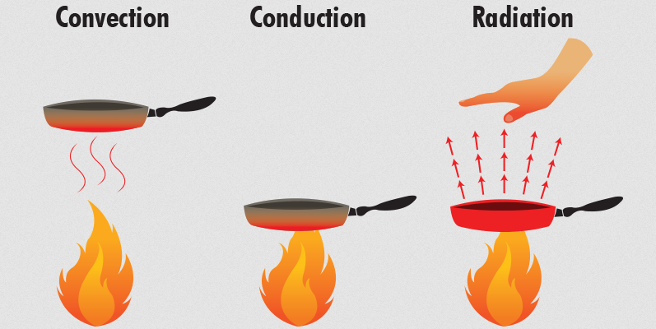
Thermal Analysis
Radiation
Why internal radiation can be ignored
External radiation calculations
Convection
Within core casing
Conduction
Contacts between caddy and core casing

Slide 6
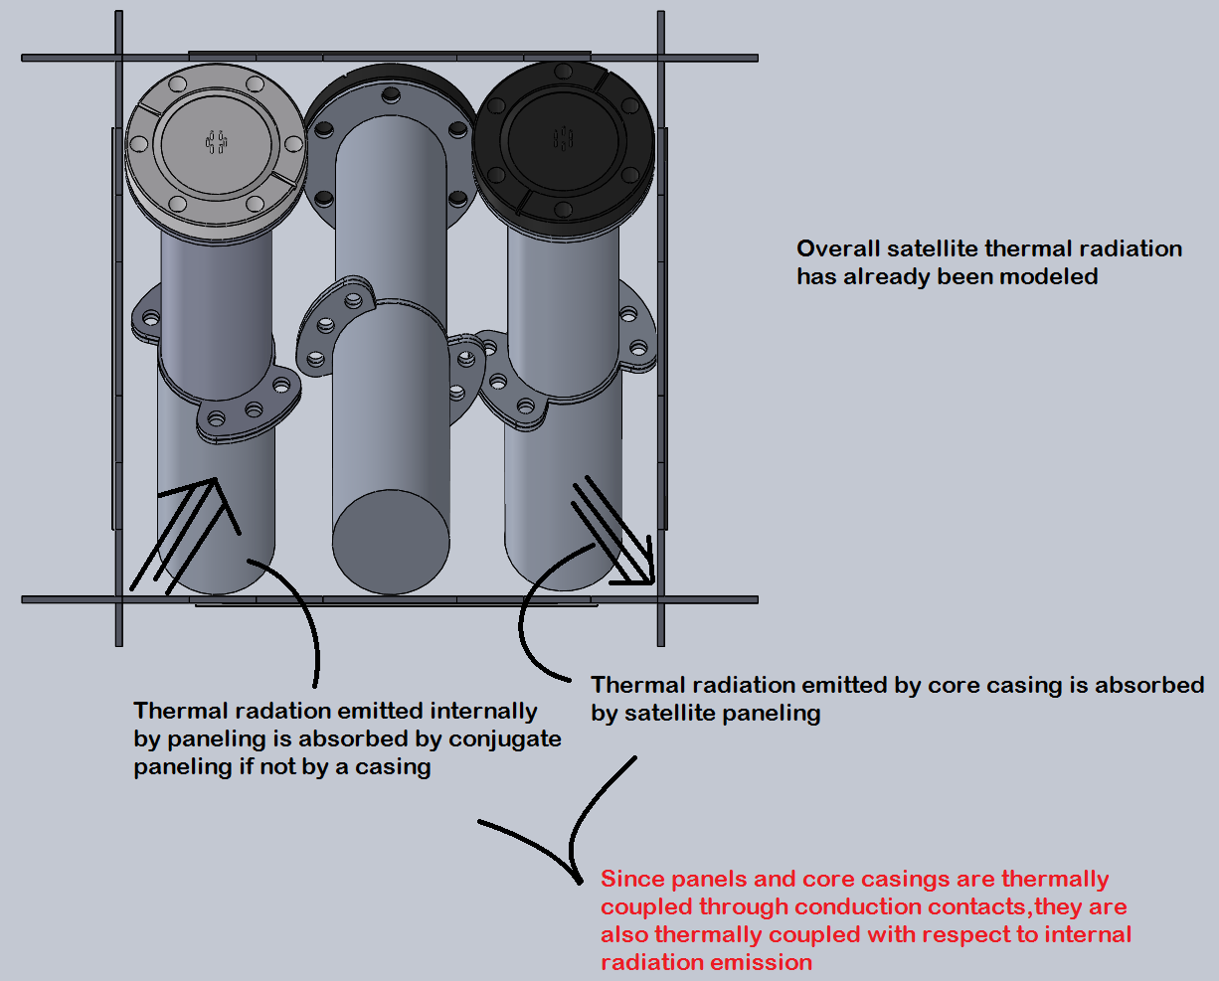
Internal Thermal Radiation Transfer
Thermal energy transfer via radiation within the scope of the 3 dimensional space between the satellite paneling, core casings, and caddies can be ignored
Why?

Slide 7
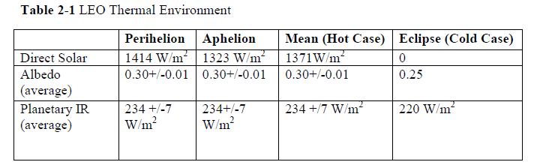
Thermal Radiation Transfer (External)
Handling satellite as a black sphere with absorptivity and reflectivity equal to 1, the following equation can be used for satellite thermal energy in sunlight.
Asurface = 4*pi*r
Asolar = Aalbedo = Aplanetary= pi*(r^2)
Q = 0 for no internal heating
F = ½ for spherical assumption
Value of 0.3 used for earth albedo
Satellite equilibrium temperature in sunlight: 24°C
Satellite equilibrium temperature in shade: -75°C
[1] D. Dinh, “Thermal Modeling of Nanosat”, San Jose State University, San Jose, CA, USA, 2012.[Online]. Available: https://scholarworks.sjsu.edu/cgi/viewcontent.cgi?referer=&httpsredir=1&article=7740&context=etd_theses

Slide 8
Computational Fluid Dynamics
CFD analysis in Solidworks prior to convection analysis
Assumption cylinders for caddy and core casing created
ABS plastic for caddy
6061-T6 Al for casing
Symmetrical design
No forced convection elements
“Natural convection” only
Exaggerated heat flow during CFD analysis
Wall heat transfer coefficient chosen to be 500 W/m^2*K

Slide 9
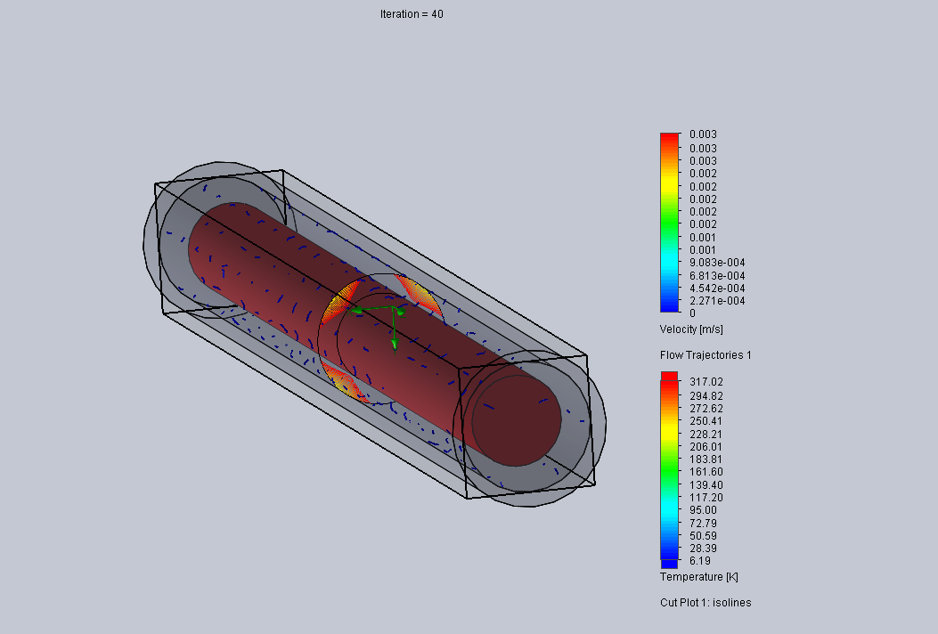
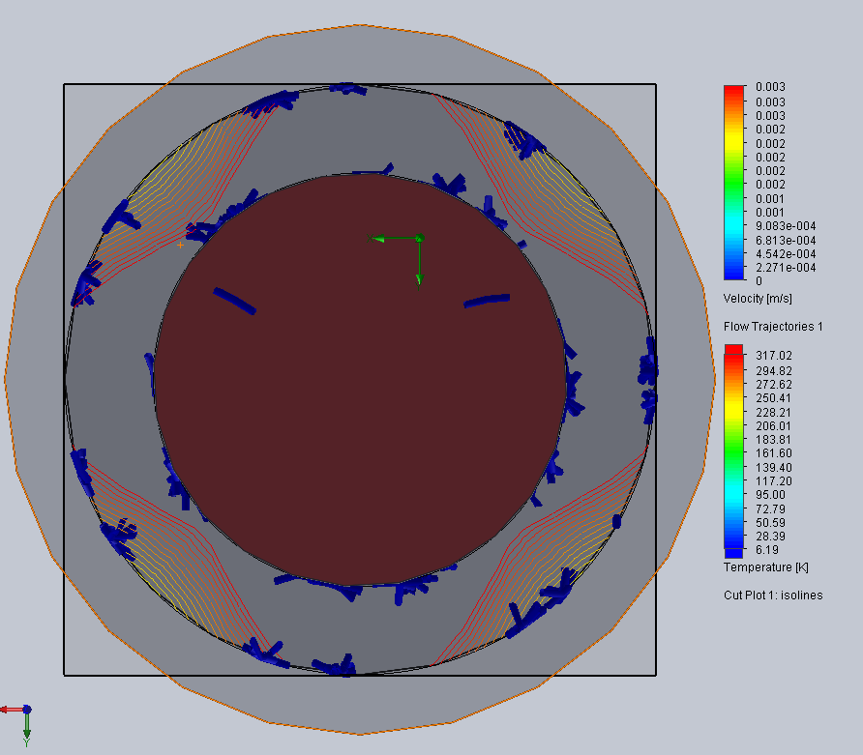
CFD Analysis Results
Velocity of air molecules in fluid subdomain between caddy assumption cylinder and casing assumption cylinder is less than 0.75 in/s
Keep in mind this air velocity is based off exaggerated heat transfer coefficients

Slide 10
Thermal Convection Simulation
Transient thermal transfer over 42 min using air trajectory data from CFD analysis
Simulation Initial Conditions
Heat flux at caddy/air and casing/air interfaces defined as 15 W/m^2 (Worst case scenario)
Casing and caddy rotated through several temperature differentials
Caddy or casing set as infinite heat source or bottomless heat sink
Results in data for worst case scenario

Slide 11
Thermal Convection Results
Negligible heat transfer, i.e. convection can be ignored
Casing T (F) | Caddy T (F) | Time (s) | Transfer (J) | Direction
-100 L | 70 UL | 2520 s | 6.1608E-12 Joules | Ca to CC
-100 L | 30 UL | 2520 s | 8.4621E-12 Joules | Ca to CC
-100 L | -15 UL | 2520 s | 1.5183E-12 Joules | Ca to CC
70 L | -100 UL | 2520 s | 5.4865E-12 Joules | CC to Ca
30 L | -100 UL | 2520 s | 5.4865E-12 Joules | CC to Ca
-15 L | -100 UL | 2520 s | 5.4865E-12 Joules | CC to Ca

Slide 12
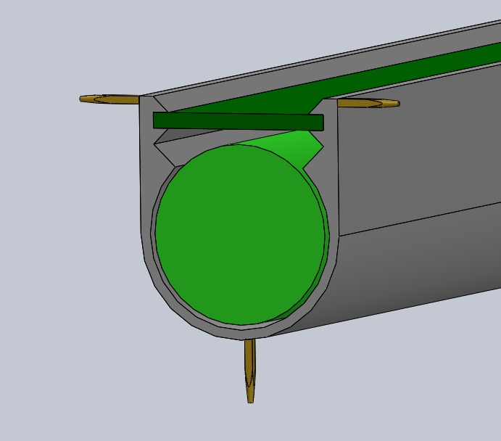
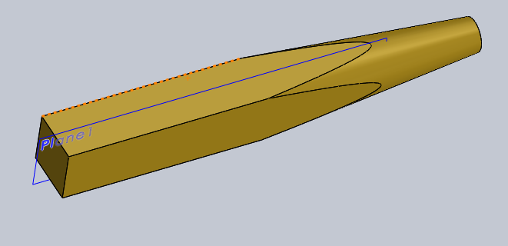
Thermal Conduction Results
Caddy is mechanically installed into core casing spaced from casing interior walls via standoffs modeled as header pins
Pin material is brass
Casing material is Al 6061-T6
Ends of header pins contacting casing walls are sanded to a fine point
Resulting contacting surface area per pin is 0.20268347 mm^2
Energy transfer in joules analyzed at max temperature differential
Result of energy transfer will be multiplied by 30 since 30 pins total standoff caddy from casing

Slide 13
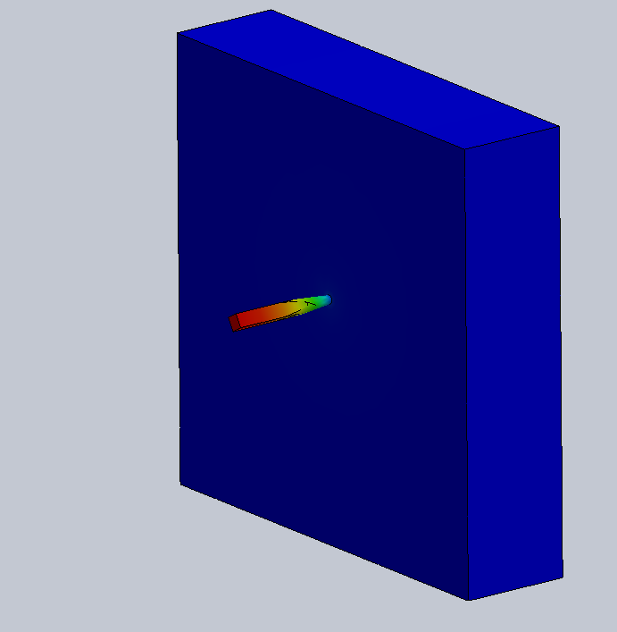
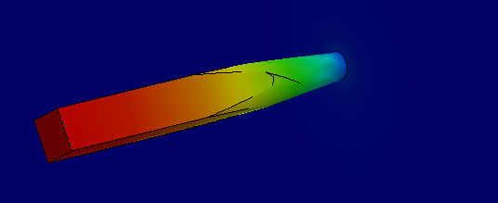
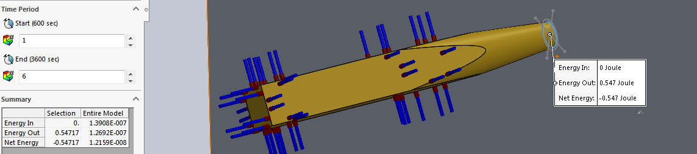
Thermal Conduction Results
1 hour thermal simulation time
Max temperature differential
-100°F to 70°F
0.547 Joules transferred through one standoff
16.41 Joules transferred through 30 standoffs
9.846 Joules transferred in shade
15.316 Joules transferred in sunlight
The net positive energy transfer will be preserved via peltier switching

Slide 14
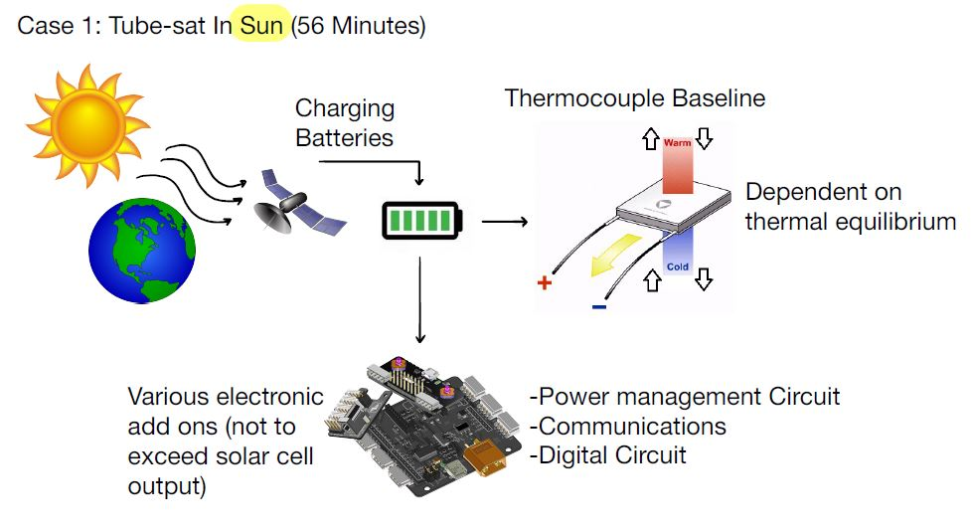
Power Budget

Slide 15
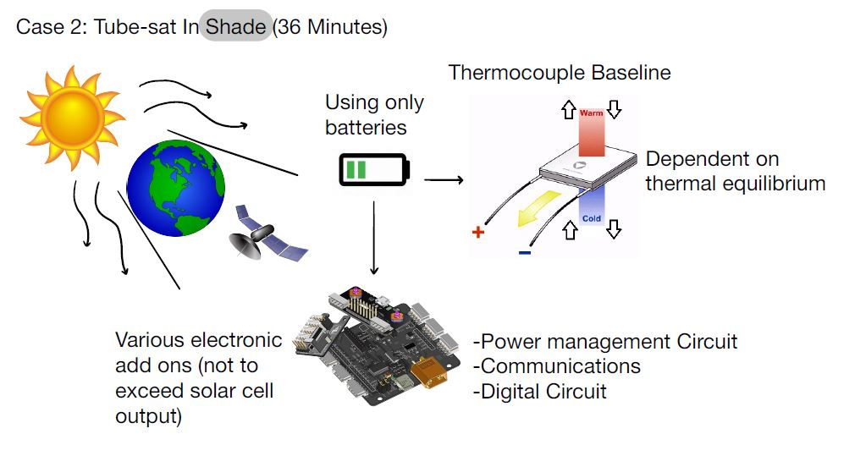
Power Budget

Slide 16
Power Budget
Power Budget
Subsystem | Power Requirement (J/s) | Energy Consumed/Provided in Shade (J) | Energy Consumed/Provided in Sun (J)
Communications Power | 2.5 | -8400 | -5400
PMC Power | 0.15 | -504 | -324
DPC Power | 0.095 | -319.2 | -205.2
Solar cell | -12.5 | 0 | 42000
Total energy consumed during 92 min orbit : 15152.4 J
Total energy provided during 92 min orbit: 42000 J
Energy left for additional applications: 26847.6 J
Can fit two more tubes within enclosure - ideally adds up to 133,056 J per pack, good for high impulse applications, however solar input remains the same
Example: COTS industrial camera draws max 5.1 W (max energy consumption of 28152 J during orbit), should be fine for images, video must be limited

Slide 17
Questions?

